Slide 1
Legal Reasoning in the US Supreme Court
Brady Earley
https://youtu.be/hsdC0nUITco

Slide 2
background

Slide 3
Motivation
Judges do 3 things when deciding cases:
1) Declare law
2) Find facts
3) Apply the law declared to the facts found
In easy cases, the law and facts match well
In hard cases, judges can either
1) issue a narrow decision (more restraint, less guidance to future courts)
2) issue a broad ruling (less restraint, more guidance to future courts)
Question: How does the US Supreme Court strike this balance?

Slide 4
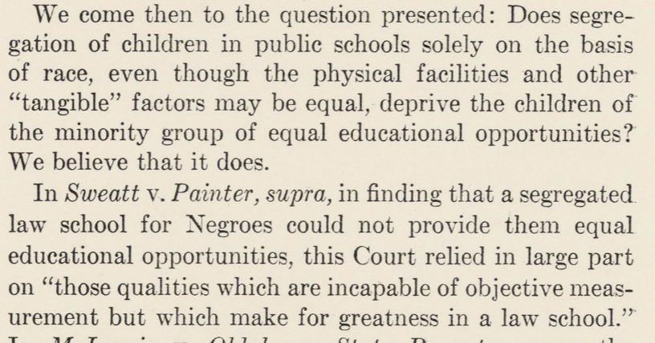
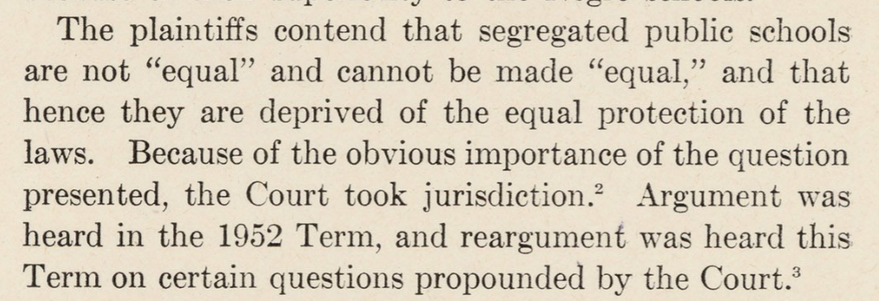
ML Task: Classify Legal Reasoning in Supreme Court Opinions
Legal reasoning involves law declaring and law applying
This project focuses on the first step to answering my research question
My task here is to first classify Supreme Court opinions into legal vs non-legal reasoning
The relevant document is a paragraph from the court opinion
This is a supervised ML task
Author labeled data for training set
Non-legal reasoning involves fact finding and procedural background

Slide 5
Data

Slide 6
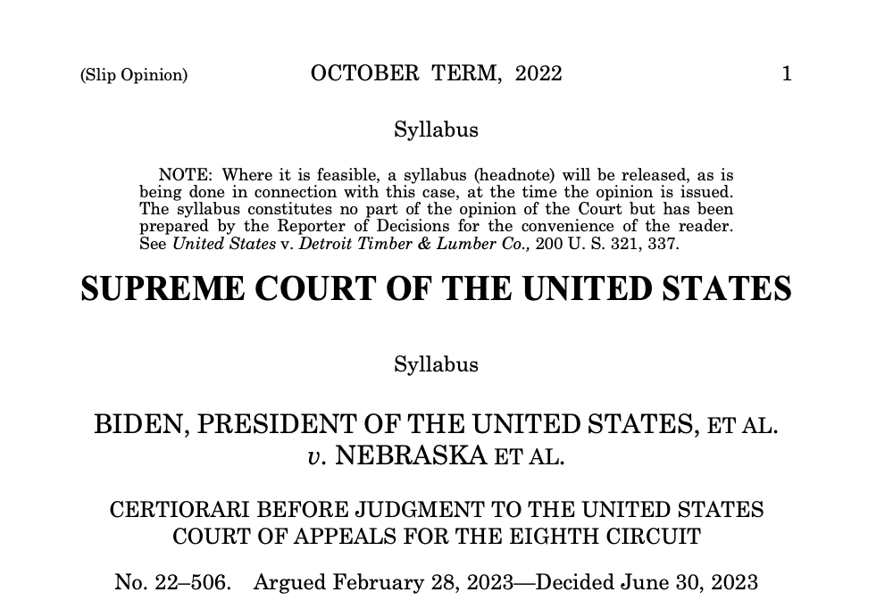
Source
CourtListener API
Supreme Court Majority Opinions since John Roberts became the Chief Justice (September 2005) to the end of 2025
3026 Opinions in total

Slide 7
Data Preprocessing
Removed duplicates (3026 opinions -> 2435 opinions)
Multiple versions housed in API
Identified true majority opinions only (2435 opinions -> 1856 opinions)
API query often included full opinion text (concurrences and dissents)
Split each majority opinion into paragraphs (1856 opinions -> 83,040 paragraphs)

Slide 8
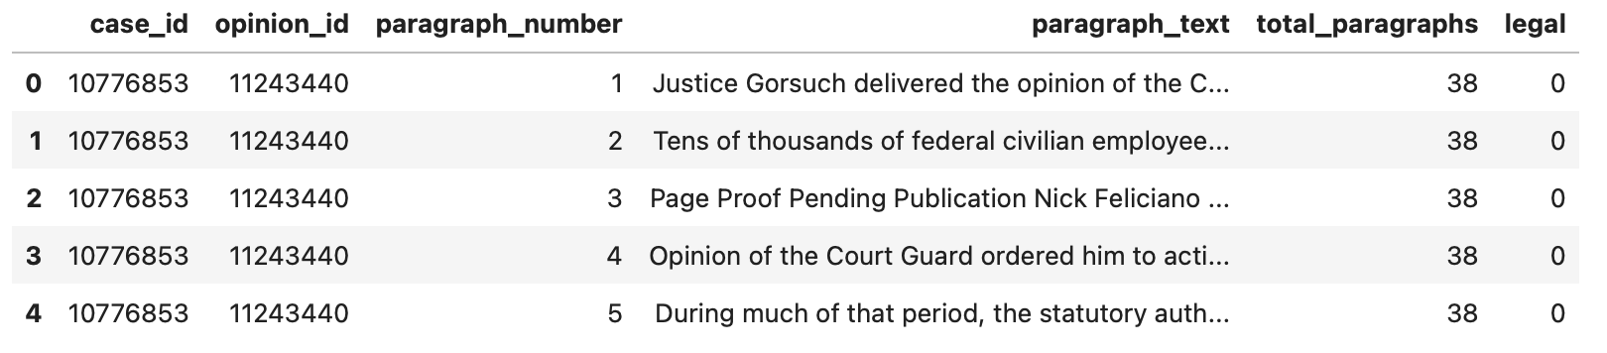
Features (numeric, text, categorical)
Case ID
Opinion ID
Paragraph Number: paragraph # within the majority opinion (e.g., 3 of 20)
Paragraph Text
Total Paragraphs: total paragraph # in the majority opinion (e.g., 20)
Legal (Target): 0 for non-legal and 1 for legal reasoning

Slide 9
Labeling
I randomly sampled 100 cases (4,953 paragraphs) to hand label
I read through each paragraph and classified it as either legal reasoning or non-legal reasoning
The labeling was based on my training in law school from reading judicial opinions

Slide 10
Models

Slide 11
DT Classifier
TF-IDF Count Vectorizer
GridSearchCV
criterion: 'gini’
max_depth: 7
min_samples_leaf: 3
min_samples_split: 2
Cross-Validation Scores (Kfold is 5)

Slide 12
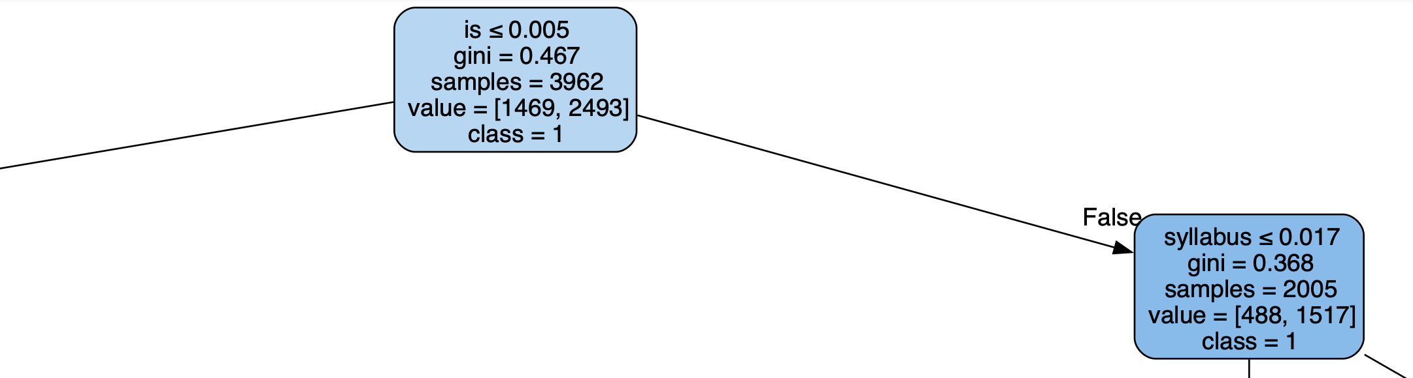
Very Low Information Gain at Top Node

Slide 13
Random Forest Classifier
TF-IDF Count Vectorizer
GridSearchCV
criterion: ‘entropy’
max_depth: None
min_samples_leaf: 1
min_samples_split: 5
n_estimators: 1000
Cross-Validation Scores (Kfold is 5)

Slide 14
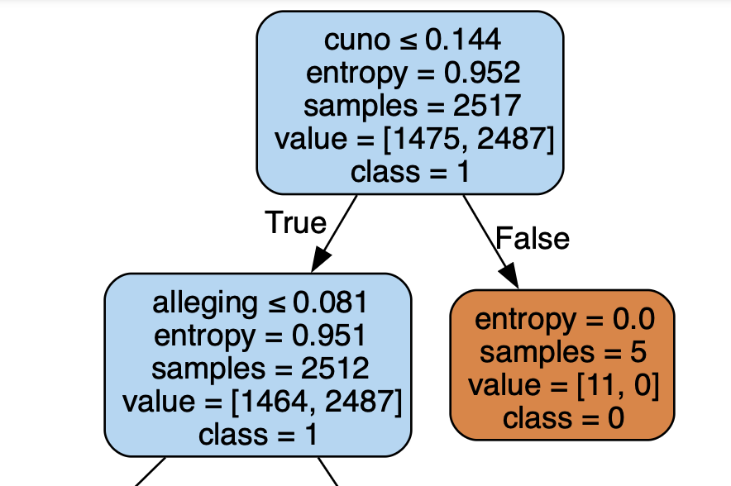
Better Information Gain at Top Node

Slide 15
Tree-Based Comparison
RF model was 2-6 percentage points higher on accuracy than DT model
Variance across RF model scores was also lower
RF is predictably better than DT for this situation given its stability and tendency to not overfit with more complex data

Slide 16
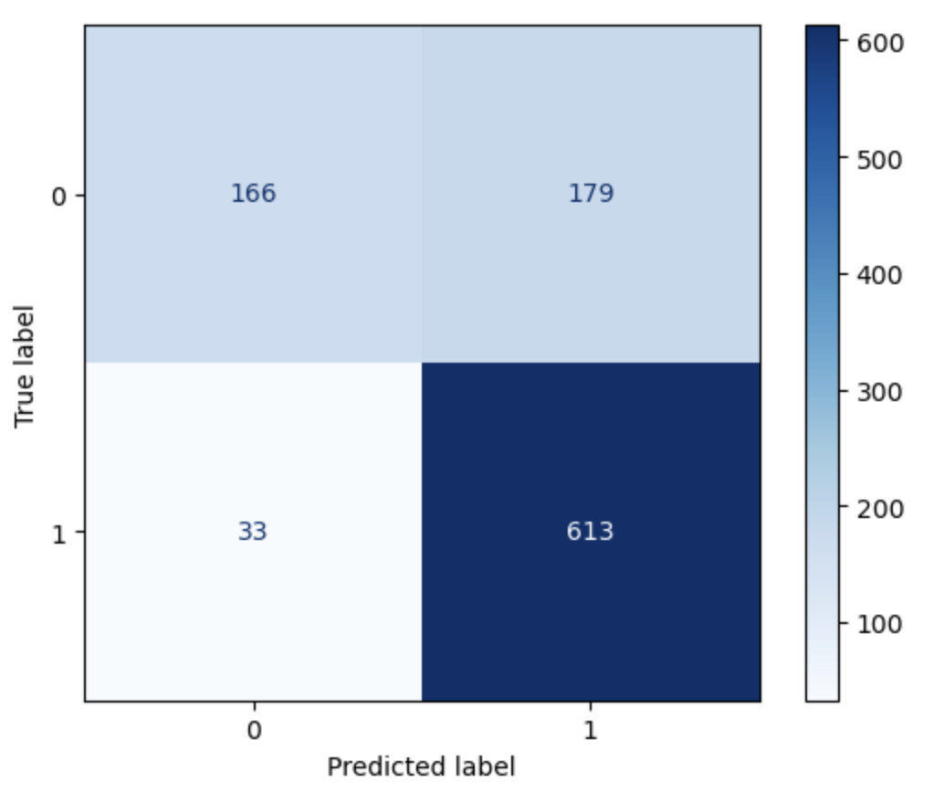
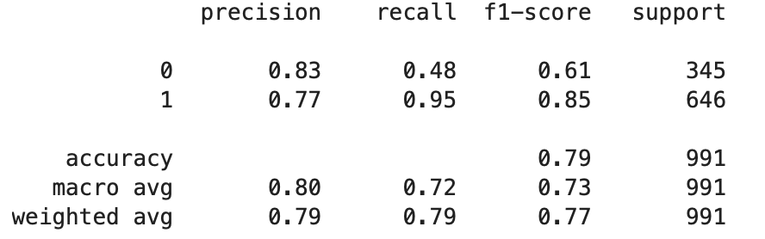
But RF still has problems
Recall is very poor
Class imbalance is likely the problem

Slide 17
Logistic Regression
CountVectorizer
More sensible with paragraphs as documents(?)
GridSearchCV
C: 10
Class_Weight: ‘balance’
Cross-Validation Scores (Kfold is 5)
Mean: 0.77
SD: 0.02

Slide 18
Comparing LR with RF
Logistic Regression
Random Forest
Accuracy: 80%
Precision: 70% (0), 85% (1)
Recall: 72% (0), 83% (1)
F1: 71% (0), 84% (1)
ROC-AUC: 0.87
Accuracy: 79%
Precision: 83% (0), 77% (1)
Recall: 48% (0), 95% (1)
F1: 61% (0), 85% (1)
ROC-AUC: 0.88

Slide 19
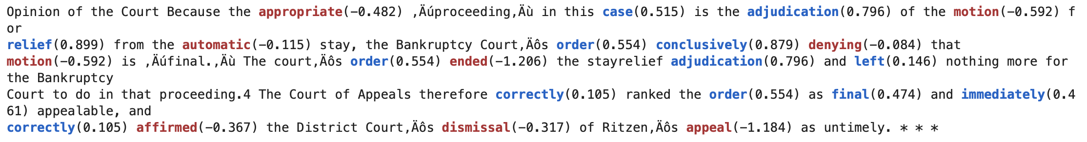
Error Analysis
Two Issues
1) Citation/Footnote Paragraphs (Legal and Non-Legal)
2) Semantic Context

Slide 20
Conclusions

Slide 21
Conclusions
Most opinions contain 2x more legal reasoning paragraphs than non-legal
2/3 to 1/3
Logistic Regression model is likely to be more appropriate for legal classifying task
Less influence from class imbalance

Slide 22
Next Steps
Refine API query and paragraph cleaning
Legal-BERT for semantic legal context
More hand labeling for future testing
Ensemble learning for model performance
Future: law declaring vs law applying!

